Slide 1



06.C Managing Users
create, modify, and delete local user accounts

Slide 2

/etc/login.defs

Slide 3


actions
[root@host ~]# useradd
[root@host ~]# usermod
[root@host ~]# userdel

Slide 4
useradd
[root@host ~]# useradd username

Slide 5
Add password
[root@host ~]# passwd username

Slide 6
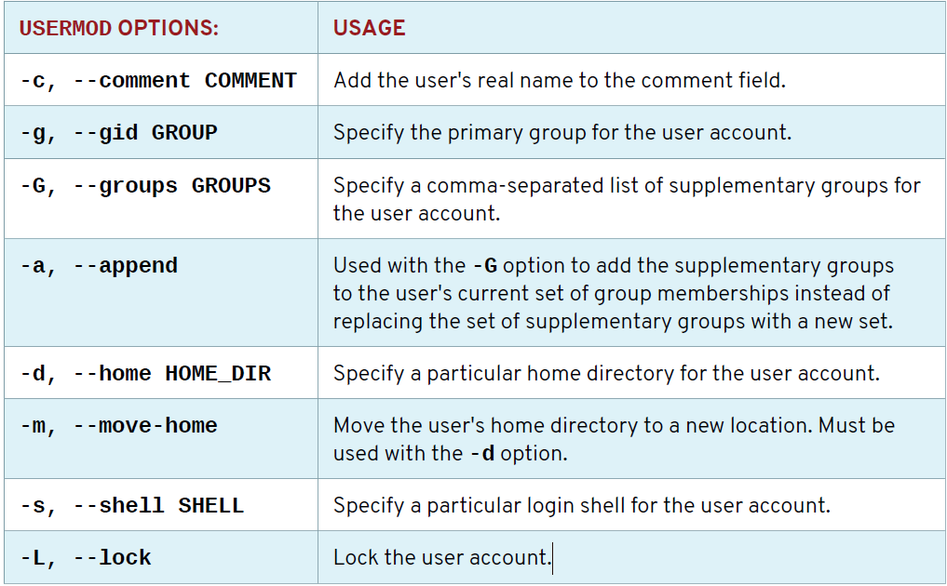
Usermod --help

Slide 7
userdel
[root@host ~]# userdel username
[root@host ~]# userdel -r username

